Slide 1
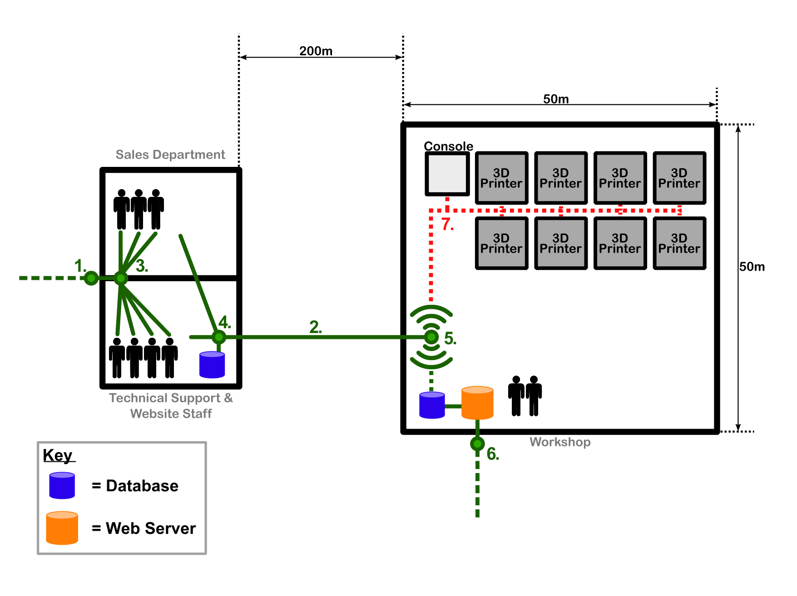
Point 7
Point 7 will manage the connection of the 3D Printers network to the business network.
Main Considerations are connection speed, reliability, mobility, security and cost.
Majority of 3D printer technologies (FDM, SLA) connect via USB or Wi-Fi.

Slide 2
Possible Solutions
Wired
USB Hub, USB 2.0/3.0 Cabling
Wireless
Router
Wireless Hub

Slide 3
Advantages
Wired Connection is much more secure and reliable.
Wired networks offer more speed than wireless.
Easier mobility of network and devices with Wireless.
USB to Ethernet adapter data rates as fast as 1000Mbps.
Disadvantages
Installing a physical link of USB and hub is more costly than a wireless setup
More cables around the warehouse for wired connection increases risk hazards in the work place.
Specifically designed printer network switches require an Ethernet connection.
USB to Ethernet adapter is more cable and expense.

Slide 4
Proposed Solution
The 3D printers will be connected to a wireless router located at point 5.
The reliability of wireless network services can be managed easier within a controlled environment such as the warehouse. (Reliability)
Technical staff will be able to connect to the network via Wi-Fi from anywhere in warehouse. This allows the management console/s to be portable. (Mobility)
A cheaper option for instalment, maintenance and potential expansion (Cost)
Security less of a concern within the warehouse as access to the environment can be controlled (Security).
Since the network printers will spend the majority of there time completing a print job and less time receiving data from the network wireless can support fast data rates for a 3D printer network. (Speed)

